Slide 1
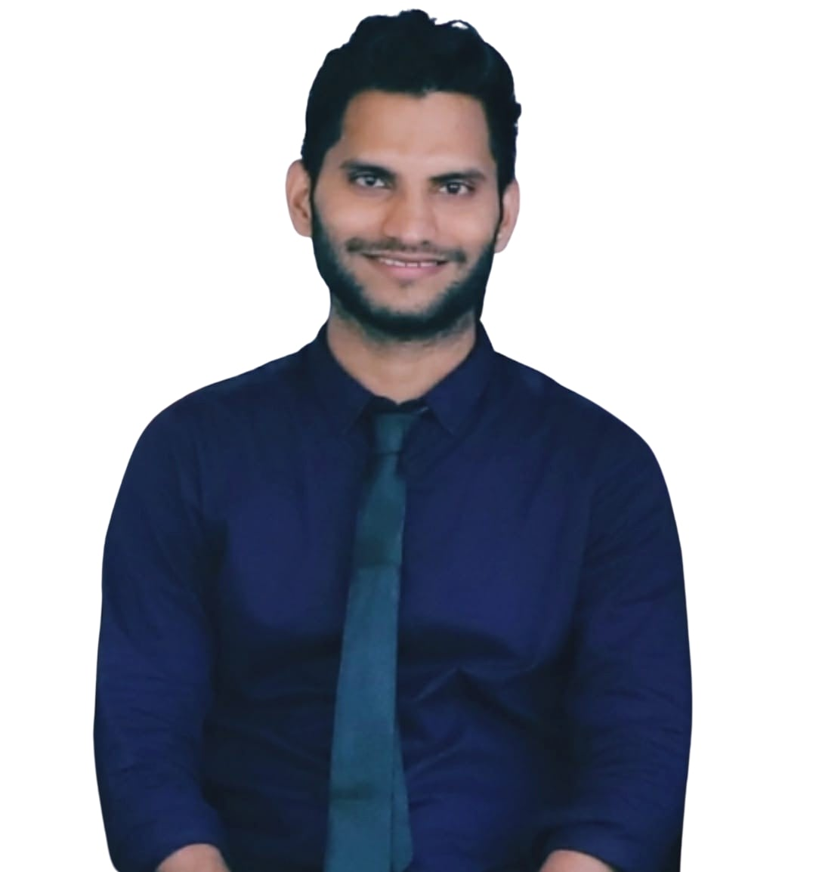
.NET Full Stack Developer
10 years of technical experience in roles including Asp. Net C#, .NET Core , MVC, SQL , Angular, React, AWS, Azure and Docker Kuber native. Completed Training with self-learning on Docker, Kubernetes, RabbitMQ, Kafka Dapper Microservices, Azure Architecture Style and Redis hands-on and Implemented MVC concepts like Dependency Injection, Middle wires, Route, and Session management technique.
Major Achievements
Functional expertise
Rupesh Jaiprakash Singh
.NET Developer Worked on various .NET Backend Applications. Developed New Data Access Layer with Redis. Focus on Performance Optimization. New Microservices Development and Support as well.
Production Support Production Support provided for various backend apps and Microservices with Cloud. Modifying existing logic and added new feature for business requirements. working closely with business stakeholders (such as traders) to resolve any issues with technical systems and applications.
Asp.net C#, MVC, Angular 10, SQL Server, React Docker, Kubernetes, RabbitMQ, Kafka Dapper Microservices, Azure, AWS, Azure Architecture Style, .NET Core, Redis Dependency Injection, Middle wires, Route, Session.
Senior Consultant
Education / Certifications
Full Stack Developer Created Responsive and Interactive Apps by Angular and React. Provided Production support and Implemented Data management and Smooth calling of Web Services.
Performance Optimization Work Done on SQL, Backend API, Data Access Layer used Caching technique and Reduce Throughput of SQL Hits. Event and Object management with Garbage Collection.
Bachelor of Science in Information Technology From University of Mumbai 2014.

